Slide 1
IT Ticket
Analysis
“Enhancing IT Support Efficiency through Data-Driven Insights”
Presented by – TEJAS K R

Slide 2
Agenda
Problem Statement
Data Description
Objective Key Metrics and Visualisations
Insights and Recommendations

Slide 3

"Industry benchmarks reveal that IT downtime costs companies an average of $5,600 for every minute of interruption."

Slide 4

Problem Statement
To fully understand the efficiency of ticket resolution, the satisfaction levels of employees, and the performance of IT agents, the IT support ticket management system needs to be analyzed.
The objective of the analysis is to evaluate the team’s overall effectiveness, identify high and low performers among IT agents, and identify areas for improvement in the ticket resolution process

Slide 5

GOAL
The ultimate objective is to improve the quality of service and the team’s performance by making responsible staffing decisions, such as hiring, firing, and training.

Slide 6
DATA OVERVIEW
Total Ticket: 97498
Tickets Sheet: Contains information about IT support tickets.
  ID: Unique identifier for the ticket.
  Ticket Fecha: Date of the ticket.
  Employee ID: ID of the employee who raised the ticket.
  Agent ID: ID of the agent assigned to the ticket.
  Request Category: Category of the request (e.g., Login Access, System, Software).
  Issue Type: Type of issue (e.g., IT Error, IT Request).
  Severity: Severity of the issue..
  Priority: Priority level of the issue
  Resolution Time (Days): Time taken to resolve the ticket.
  Satisfaction Rate: Satisfaction rate provided by the employee (1-5 scale).
IT Agents Sheet: Contains information about IT agents.
  Agent ID: Unique identifier for the agent.
  Full Name: Full name of the agent.
  Email: Email address of the agent.
  Year of Birth: Year the agent was born.
  Month of Birth: Month the agent was born.
  Day of Birth: Day the agent was born.

Slide 7
METRIC 1: “TICKET COUNT BY TIME (YEAR)”
This tracks the total number of tickets created each year.
It helps in understanding year-over-year trends and analyzing ticket volumes over long periods
Analysis:
This chart shows a consistent year-over-year increase in the total number of tickets created from 2016 to 2020.
The ticket volume has grown steadily, with significant growth observed between 2019 (21,490) and 2020 (29,088), indicating an accelerating trend in ticket creation.
This growth could reflect expanding operations, increased demand, or enhanced reporting mechanisms.

Slide 8
METRIC 2: “TICKETS BY REQUEST CATEGORY”
Tickets are grouped into predefined categories such as Hardware, Login Access, Software, and System, and the count is determined for each.
This shows which category generates the highest or lowest number of requests, allowing for better resource allocation.
Analysis:
This chart indicates that System-related tickets constitute the largest share at 39,002, followed by Login Access (29,193) and Software (19,570), with Hardware having the lowest proportion at 9,733.
The dominance of System tickets suggests it requires the most resources, while Hardware issues may need less focus.
This breakdown can guide targeted resource allocation

Slide 9
METRIC 3: “TICKET COUNT BY SEVERITY RATE”
This group’s tickets are based on their severity and provide the total count for each category.
0-Unclassified, 1-Minor , 2-Normal, 3-Major, 4-Urgent.
It highlights the proportion of tickets with varying levels of urgency.
Analysis:
This chart shows the distribution of tickets by severity levels, with severity 2 having the highest count (88,656), indicating
It is the most common urgency level. Severities 3 (4,836) and 1 (2,258) follow, while severities 0 (356) and 4 (1,392) are comparatively rare, suggesting that most tickets fall into mid-level urgency.

Slide 10
METRIC 4: “TICKETS BY PRIORITY”
This categorizes tickets based on their assigned priority levels and tracks the total count in each category.
0- Unassigned, 1- Low, 2- Mid, 3- High
It identifies the tickets requiring immediate attention.
Analysis:
This chart depicts the distribution of tickets by priority level. Priority 3 has the highest count (35,549), indicating the largest number of tickets requiring immediate attention.
Priorities 0 (29,410) and 1 (16,694) follow, while priority 2 (15,845) has the smallest share.

Slide 11
Metric 5: “Distribution of tickets based
on satisfaction”
This metric examines how tickets are distributed across various customer satisfaction levels.
For example, tickets may be grouped by satisfaction scores (e.g., 1–5), showing the proportion of satisfied vs. dissatisfied customers.
Analysis:
Satisfaction score 5 has the highest number of tickets (50,770), followed by score 4 (27,562), indicating a significant majority of positive feedback.
Lower scores, especially 2 (1,977) and 3 (7,282), represent smaller proportions, suggesting relatively fewer dissatisfied customers.

Slide 12
Metric 6: “Average Resolution Time by Request Category Quarterly”
This shows the average resolution time for different request categories (Hardware, Login Access, Software, and System) across four quarters.
It provides a periodic view of resolution efficiency.
Analysis:
Hardware consistently takes the longest to resolve (~7.5–7.7 hours), while Login Access is the quickest (~0.3 hours).
Resolution times for Software and System remain steady across quarters at ~5.2–5.3 and ~6.6 hours, respectively, indicating consistent performance in these areas.

Slide 13
Metric 7: “Satisfaction Rate By Time (Year)”
This measures customer satisfaction rates (e.g., 1-5) and tracks how they change over the years.
It’s useful for identifying long-term trends in customer experience
Analysis:
The chart shows a gradual improvement in customer satisfaction rates over the years, starting at 4.0 in 2016 and reaching 4.2 in 2020.
While the increase is modest, it indicates a steady positive trend in customer experience. Maintaining or accelerating this trend could further enhance customer satisfaction.

Slide 14
Metric 8: “Satisfaction Rate By Age-groups”
This analyzes satisfaction rates across different agent age groups (e.g., 24–27, 28–31, etc.).
It explains how satisfaction levels vary based on demographic factors.
Analysis:
The 48–51 age group shows the highest satisfaction rate at 4.4, while the 36–39 age group has the lowest at 3.9.
Younger and middle-aged groups (“24–27” and “32–35”,”40-43”,”44-47”) also report relatively higher satisfaction rates, indicating that older and younger demographics may have different expectations or experiences.

Slide 15
Metric 9: “Distribution Of Tickets Based On Resolution Time”
This demonstrates the efficiency with which tickets are resolved and highlights areas for process improvement.
Analysis:
The chart indicates that a majority of tickets (over 25,000) are resolved on the same day (0 days), showcasing strong efficiency in immediate resolution.
A significant number of tickets take longer, with noticeable peaks around 1, 5, and 6 days, suggesting possible bottlenecks or complex cases requiring more time.
Process improvements could focus on reducing resolution times beyond the first day to enhance overall efficiency

Slide 16
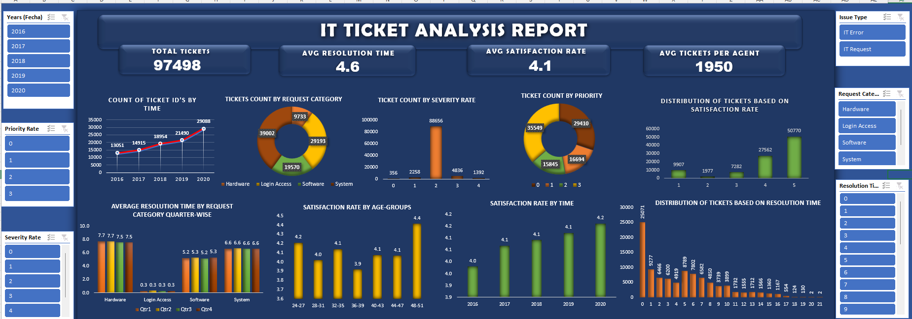
DASH BOARD

Slide 17
CONCLUSION: COMPREHENSIVE ANALYSIS OF IT SUPPORT OPERATIONS
Agent Performance:
  The overall performance of IT agents is satisfactory, with an average resolution time of 4.5 days and a consistent satisfaction rate of 4.1.
  Specific agents with prolonged resolution times and lower satisfaction scores require targeted training programs to address skill gaps.
Category Insights:
  Hardware requests have the longest resolution times (7.63 days) and demand immediate process optimization.
  Login access issues are resolved quickly (0.31 days), indicating efficient handling.
Workload and Trends: As a result of rising demand for IT support, ticket volumes have been rising gradually and reached a peak at the end of the year. The team has demonstrated efficient resource management by maintaining consistent satisfaction levels in spite of increasing volumes.
Efficiency of Software Tools: The ticket management systems in use today are mediocrely effective, but they could be better, especially in terms of speeding up resolution times for system and hardware categories.

Slide 18
RECOMMENDATIONS
Investment Priorities:
  Training programs and software upgrades should be prioritized over hiring new agents to enhance resolution efficiency.
  Investment in technology can improve resolution times for high-complexity requests without significantly altering satisfaction rates.
Future Focus Areas:
  Process Optimization: Streamline workflows for complex request categories (e.g., hardware and system).
  Data-Driven Decisions: Monitor agent and ticket trends regularly to identify improvement areas.
  Balanced Resource Allocation: Address peak workload periods through proactive resource planning and efficient prioritization.

Slide 19
THANK YOU

